Slide 1

VENTURE STUDIO OVERVIEW
July 2022
Strictly Confidential

Slide 2

Digital Living and
Connectivity
Digital Impact, is a Venture Studio dedicated to co-launching a portfolio of companies in digital transformation to generate a measurable, beneficial social or environmental impact (ESG) alongside a financial return. We work with large projects and investors to help seed innovation through a broad range of digital living related businesses that aims to democratizes connectivity while bringing efficiencies to connectivity projects and transformative connected applications in Health, Education, Governement and other enabling industries to improve quality of life .
Strictly Confidential

Slide 3
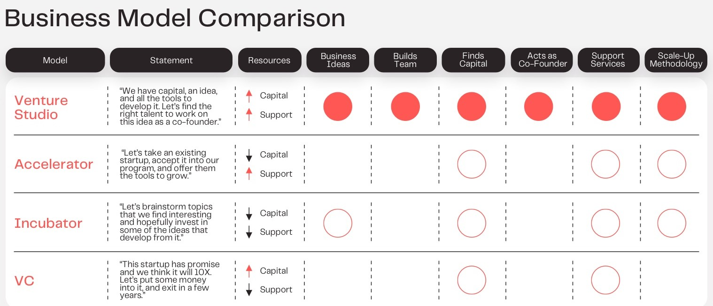
What is a Venture Studio ?
The goal is to have facilitated digital transformation across many industries and impact close to 1M North Americans by 2025
A venture studio framework is a new model for entrepreneurship, combining company building with venture funding. By design, venture studios play the role of matchmaker, linking business ideas to their talented counterparts to execute those ideas.
Venture studios help entrepreneurs grapple with the unknowns of building a new company by providing them with an initial capital amount, operational support and an intellectual property framework. A venture studio’s main goal is to found as many successful co-launched companies as possible — all from the ground up.
More details on Venture Studios a https://theworldwecreate.net/insights/the-venture-studio-business-model-explained
Strictly Confidential

Slide 4
Our Mission
As a Venture Studio, the objective at Digital Impact is to help spark and accelerate companies that bring impact in connectivity and digital transformation in Health, Education and Government to maximize impact on social, environmental and governance (ESG) challenges.
Following the recent events in the world with regards to COVID-19 it has forced communities to leverage telecare, e-health, teleworking which resulted in unprecedented Internet traffic. Moreover these facilities are now seen as strategic and people understand that they can deliver more than the traditional triple-play.
They represent the roads of the future and as such need to be part of the public infrastructure available to the communities. In unserved and underserved areas the legacy telecom business model is hard to justify and single shared infrastructures need to be deployed in order to avoid facilities based competition in favour of a service-based competitive landscape with both traditional and digital transformation services.
The portfolio companies will lower the costs of the infrastructures, improve efficiencies in operations and provide emerging services that will change our lives.
Strictly Confidential

Slide 5

Portfolio Strategy
Digital Transformation Projects usually follow the following Lifecycle
Design
Finance
Maintain
Integrated Design to Evaluate Scenarios
Prepare Investment Vehicles & List
Maintain the Infrastructure
Build
Operate
Track and Manage the Build
Operate the Infrastructure
Our portfolio strategy: Identify and fill the gap creating top-down start-up with immediate revenue in partnership with large companies and small aquisition of troubled companies with valuable IP asset.
Strictly Confidential

Slide 6
Total addressable market (TAM)
Digital Impact addresses Digital Transformation needs across different markets
Total Canadian AM of C$20.2G
(in $billions)
Total American AM of C$175G
(in $billions)
DIH will leverage its current ecosystem and its connections with valuable players in the market to achieve it’s market strategy. We will also focus on direct market development by creating new connections and solidifying the existing with governments, municipalities and First Nations.
Strictly Confidential

Slide 7
Total addressable market (TAM)
Digital Impact addresses Digital Transformation needs across different markets
The growing need for connectivity throughout Canada, the United States and elsewhere in the world, which has been exacerbated by the impacts of the pandemic on all spheres of society, is now generating a wave of B$ investments that is expected to stretch over the next 7 to 10 years minimum.
These investments, combining multiple sources of funds, both public and private, are taking place in a sector characterized by high technological and business complexity, knowledge fragmentation and multiple supply chain challenges.
Conclusion:
Considering the market characteristics listed above, the Canadian connectivity market led by non-incumbents is highly fragmented and sub-optimal in terms of access to best practices, innovative technologies and systems, costs (CAPEX and OPEX) and project financing.
The strong potential of the rural connectivity markets in Canada and the United States and the acceleration of a of major investment cycle in 2022-2027 justifies the search for an innovative and holistic solution to the challenges identified.

Slide 8
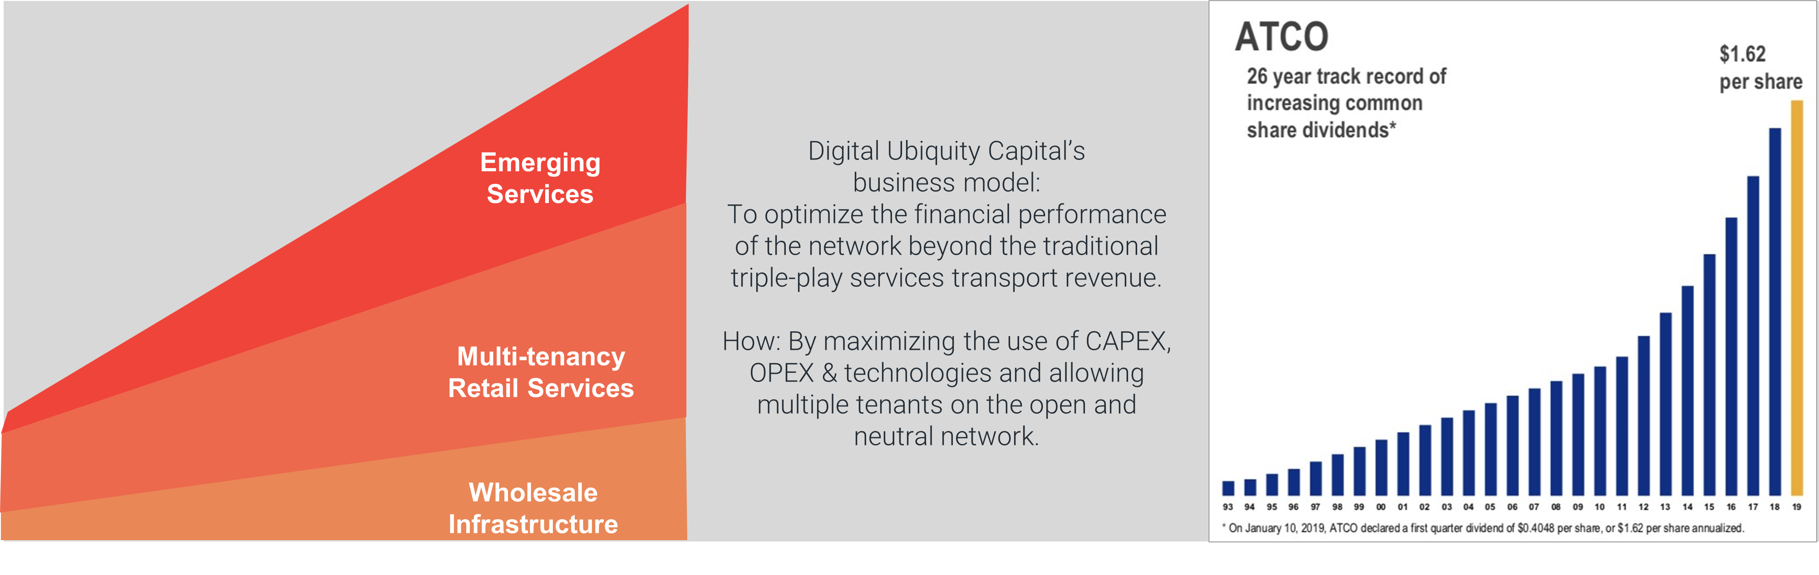
DUC: a valuable partner
Digital Impact addresses Digital Transformation needs across different markets
DUC provides project analysis and oversight on connectivity projects and implements a set of performance indicators to be achieved for each project.
DIH leverages its relationship with Digital Ubiquity Capital (DUC) and positions itself as the main provider of state-of-the-art products and services essential in the value chain of a connectivity project and in developing the new generation open networks.

Slide 9
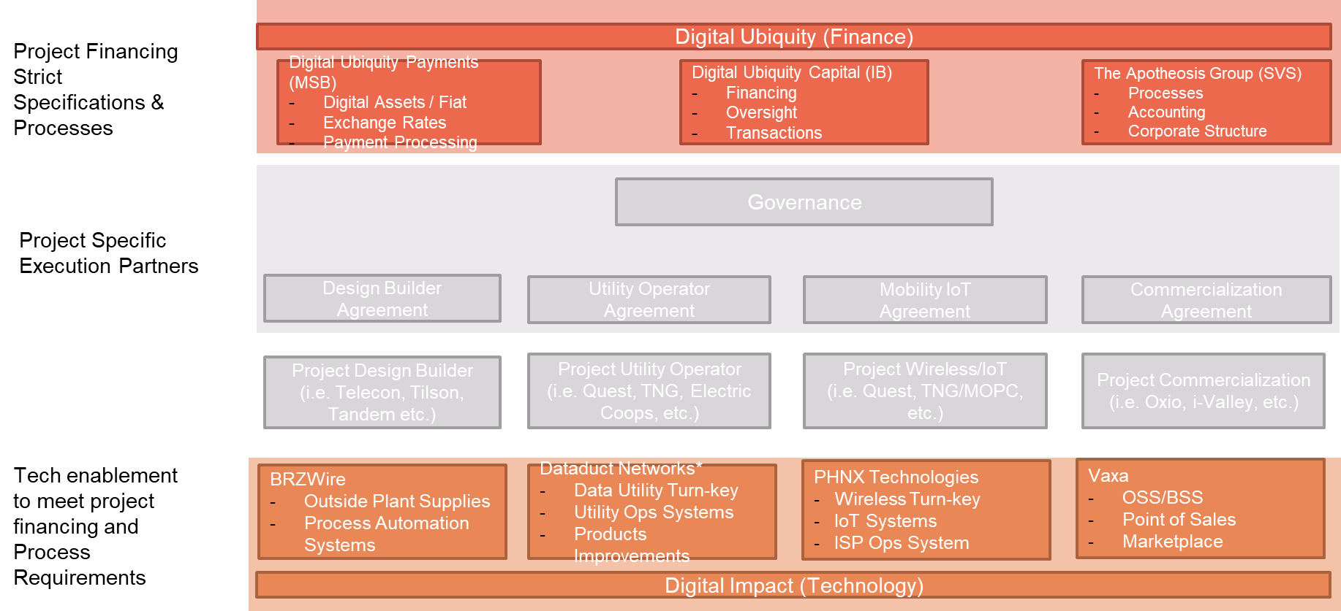





DUC SOLUTION: A DISTINCTIVE HOLISTIC APPROACH
A key differentiation factor: 2 thin strategic layers to improve projects
The vision and tools developed by DUC since 2019 and more broadly by its founders since 2014 have positioned the company today as a leader in connectivity project governance and management, responding in a unique and innovative way to the needs encountered by stakeholders involved in connectivity projects.
Strictly Confidential

Slide 10




Partnerships with communities
The Incubated Compagnies must be working directly with their community in real life community project (Living Labs)
>100M
10M-100M
1M-10M
<1M
Smart City
Smart Towns
Smart Campus
Smart Buildings
Smart City projects are ultra scale projects that aim at providing digital infrastructure for security, organization and wellbeing of the city life.
Smart Town projects focus on rural to suburban communities and provides the infrastructure with a focus on telecare, precision agriculture and mining.
Smart Campus projects focus on university campuses or large enterprise campuses with a focus on education, IoT and productivity.
Smart Buildings focuses on working with developers of MDU/MTU on building’s shared infrastructure to enable IoT, HVAC, IP CCTV and tenant services.
Strictly Confidential

Slide 11
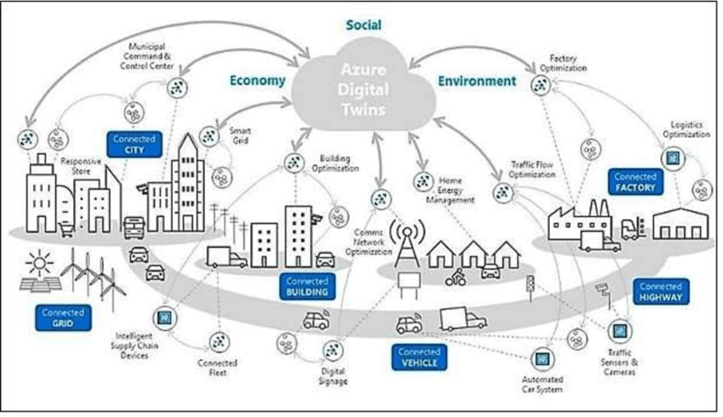
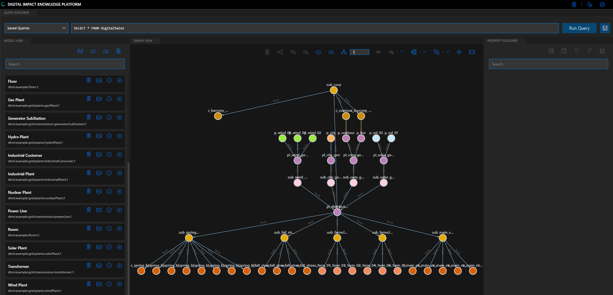
Digital Twin as a unified thread
The value of Digital Impact is to leverage shared Intellectual Property on Digital Twin and relevant middleware frameworks
Synergies & Quick MVP
At the heart of Digital Impact Ecosystem is a Hosted Knowledge Platform for Digital Twins that allows for interactions between the data leveraged between entities and relationship between the various twin objects and areas of expertise represented accurately in a digital world.
Strictly Confidential

Slide 12
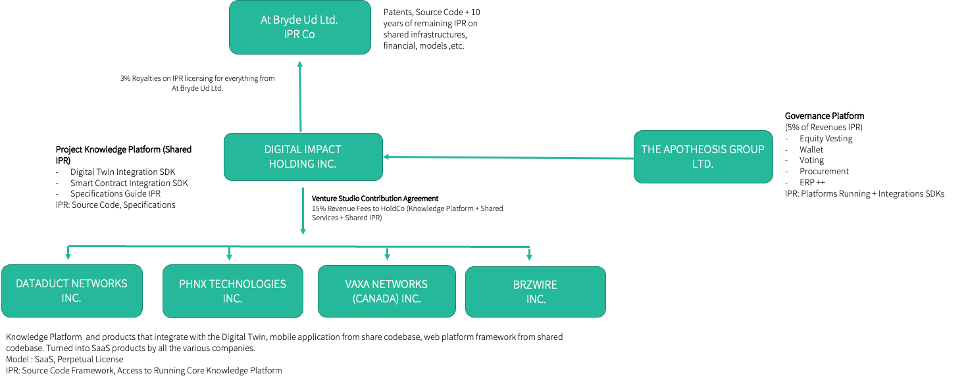
Leverage Intellectual Property
Digital Impact leverages years of IPR and provides shared middleware for quick start of portfolio companies solutions
Strictly Confidential

Slide 13
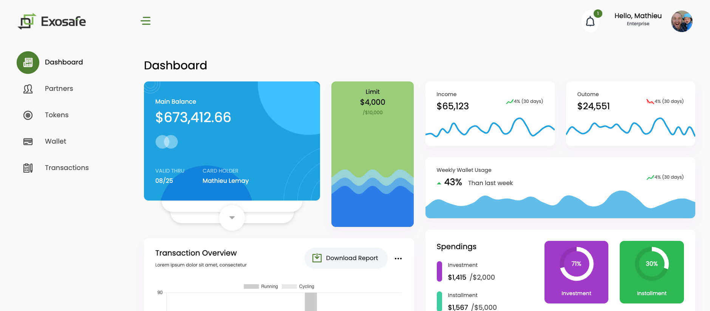
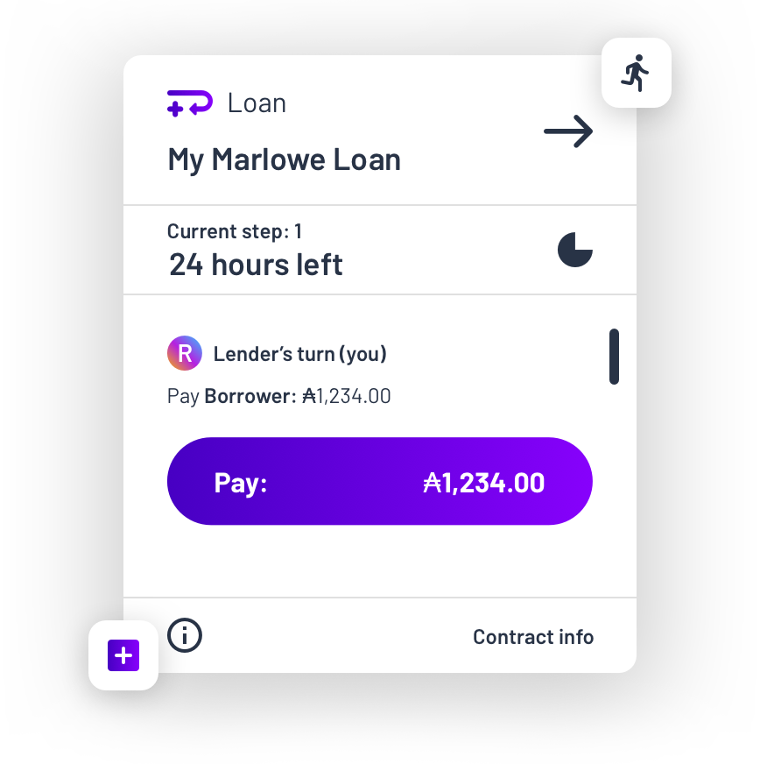
Governance
Digital Impact uses a Governance Platform
Risk Management
Digital Impact uses a “token” based approach to managing the portfolio companies helping them determine their real spend capacity for proper KPI and performances and provides funds and loans via smart contracts of these tokens to properly track all the money flows are provide funds conservatively based on milestones accomplishments by the CEOs.
Strictly Confidential

Slide 14
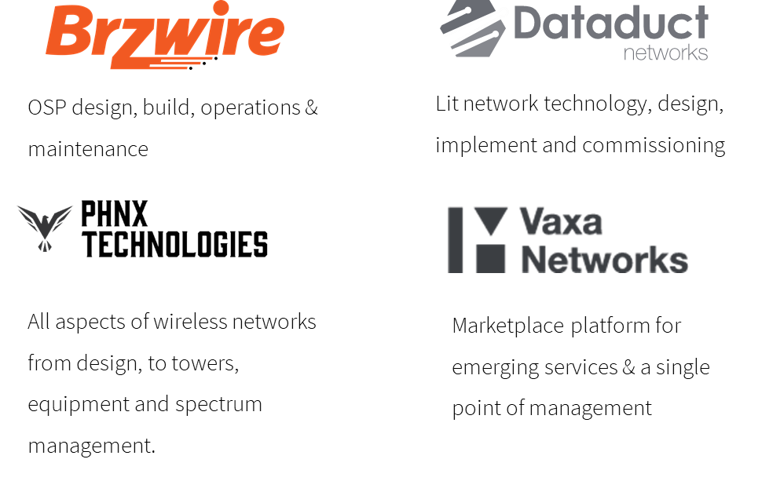
Portfolio
Digital Impact has the following portfolio of co-launched entities
Strictly Confidential

Slide 15
Graduation Process
Companies must follow a 4 Step structure towards “Graduation” out of DIH
Help companies identify and strive for product-market fit for their business plan & process (Business Canvas, etc.) by working existing gaps in projects.
Create Product & IPR relative to the company with an anchor project & customer leveraging an aspect of digital twin and DIH shared IPR for quick MVP.
Upon successful MVP and product-market fit, build a strong team of experienced individuals around the company.
Close business and deals > 2M in annual revenue with 3 different customers and a profitable or break-even EBITDA. (No burn rule)
Plan
IP
Team
Deals
Strictly Confidential

Slide 16
Current Pipeline
Project Name | Developer | Project Size | Status | Estimated % as of April 2022 | Potential Revenue for DIH Entities
MOPC – Phase 2, 2022-2023 Nova Scotia | Municipality of Pictou County, N-S | 35 M $ | Budget voted by council. P.O. expected April-May 2022 | 85 % | 12-15 M $
Telecon Inc/Project X Nova Scotia | Telecon | 0 M $ | P.O. to BrzWire confirmed. Contract under discussions | 90 % | +150 K
Enbridge Partnership, B-C | Enbridge & Plenary, B-C | 60 M $-70 M $ | Preliminary discussions. Business plan expected Q3 2022. Project start 2023. | 15 % | 7 M $
Digicom-Outaouais & Gatineau, Qc | Digicom Inc., Qc | 40 M $ | Projects and grants confirmed. P.O. under discussions to be confirmed | 20 % | 2 M $
Samson Cree First Nation, AB | Smoke Signal Inc., AB | 30 M $ | Preliminary discussions. Business plan expected Q2 2022. Project start 2023. | 10 % | 2.5 M $
METTA-Quartier Laval | BMP Devco/Claridge | 3 M $ | Business plan expected Q2 2022. Project start 2022. | 15 % | 2 M $
Total estimated pipeline 2022-2023 |  |  |  |  | 25.65 M $-28.65 M$
Plan
IP
Team
Deals
Strictly Confidential

Slide 17
Revenue Forecast & Financials
Financial projections by quarter for the years ending December 31, 2022 to 2024
Revenue projections are
mostly supported by
contracts on hand and purchase order projections.
 | YEAR 2022 |  |  |  |  | YEAR 2023 |  |  |  |  | YEAR 2024
in CAD | Q1 | Q2 | Q3 | Q4 | TOTAL | Q1 | Q2 | Q3 | Q4 | TOTAL | Q1 | Q2 | Q3 | Q4 | TOTAL
Revenues | 534,127 | 650,905 | 1,461,902 | 2,667,747 | 5,314,681 | 1,753,965 | 1,253,753 | 3,484,655 | 4,399,426 | 10,891,799 | 3,465,995 | 3,817,994 | 5,188,162 | 5,626,197 | 18,098,347
Cost of revenues | 267,524 | 435,372 | 1,126,424 | 1,998,761 | 3,828,081 | 1,322,831 | 1,048,440 | 2,626,276 | 3,044,587 | 8,042,133 | 2,622,171 | 2,805,906 | 3,930,774 | 4,041,064 | 13,399,915
Gross profit | 266,604 | 215,533 | 335,478 | 668,985 | 1,486,600 | 431,134 | 205,313 | 858,380 | 1,354,839 | 2,849,665 | 843,824 | 1,012,088 | 1,257,387 | 1,585,133 | 4,698,432
Gross margin | 50% | 33% | 23% | 25% | 28% | 25% | 16% | 25% | 31% | 26% | 24% | 27% | 24% | 28% | 26%
Operating expenses | 316,227 | 413,948 | 401,385 | 396,970 | 1,528,530 | 571,632 | 645,065 | 581,100 | 514,731 | 2,312,529 | 624,802 | 698,619 | 639,389 | 596,938 | 2,559,748
net of grants and SRED
Income taxes | 13,504 | - 26,024 | - 4,001 | 58,127 | 41,606 | 4,259 | - 71,777 | 45,621 | 179,654 | 157,757 | 33,930 | 61,053 | 105,113 | 195,858 | 395,954
Net profit | - 63,127 | - 172,391 | - 61,906 | 213,888 | - 83,535 | - 144,757 | - 367,975 | 231,658 | 660,454 | 379,379 | 185,092 | 252,416 | 512,885 | 792,336 | 1,742,729
EBITDA | - 44,369 | - 193,161 | - 36,286 | 301,636 | 27,821 | - 112,037 | - 411,291 | 305,741 | 868,569 | 650,982 | 241,488 | 335,935 | 640,464 | 1,010,661 | 2,228,548
Strictly Confidential

Slide 18
Cash Flow and Financing Needs
Financial projections by quarter for the years ending December 31, 2022 and 2024
DIH would require $1.5M to $2.0 M CAD in subordinated debt financing to accelerate the growth of its current portfolio companies
and acquire new potential ones.
Financing Modalities :
Continuous interest payment 48 months at market rate, capital discharge for the first 12 months
Principal repayment months 13 to 48
Strictly Confidential

Slide 19
Summary
Digital Impact addresses Digital Transformation needs across different markets
Technology
Impact
Unique Products & Solutions
Multiple MVPs across the portfolio in living lab trials
Patents & Copyrights across the components
Shared Value and Value Creation
Impact on Healthcare (COVID-19), Education and Government
Synergies between operating companies to maximize value
Long Term infrastructure investments
Impressive community pipelines
Operations
Influence
Experienced Executives support
Automated Internal Processes for tracking and accounting
Work closely with Capital groups for investment vehicles
Lean & Profitable Operational Companies
Relationship with large projects like CENGN, ENQOR, etc.
Long history of Interactions with Government Agencies
History of SDN pioneers in the industry
Ecosystem of Partners across the industry
Strictly Confidential

Slide 20


Final Words
At Digital Impact we will continue to actively invest in Technology companies that will help democratize connectivity to have a environmental and social impact while providing the appropriate returns to our stakeholders. Through the active management of this portfolio we will be at the forefront of the billions of dollars that will be invested over the next 5 years in telecommunications infrastructures to bridge the digital divide in North America.
Roch Charbonneau
CEO
Strictly Confidential

Slide 21
Digital Impact
1 University,Ave
Toronto, ON
Digital Impact (HQ)
15, Jos-Montferrand
Gatineau, QC
Digital Impact
3713 Mont-Royal Est
Montreal, QC

